Slide 1


XN PROJECT: Individual Draft Presentation
ALY 6080​ Prof. Atherley Valarie
By
Sunil Raj Thota

Slide 2
Introduction
Project Requirements – Analysing the Data using Exploratory Data Analysis
Job Assignments – All the tasks were able to work by everyone with flexibility
Measure of Success – Costs, Quality, Scheduling, Stakeholder Satisfaction, and Performance
Milestones – Leading the team in the right direction to enable the goals
Risks and Strategies – Identifying Strategies as per the Business needs

Slide 3
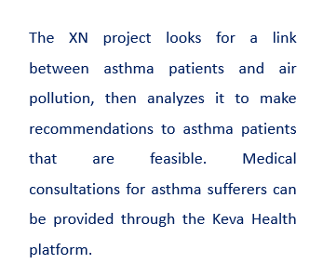
Executive Summary
Data Collection
Visual Infographics
Satisfaction Survey

Slide 4
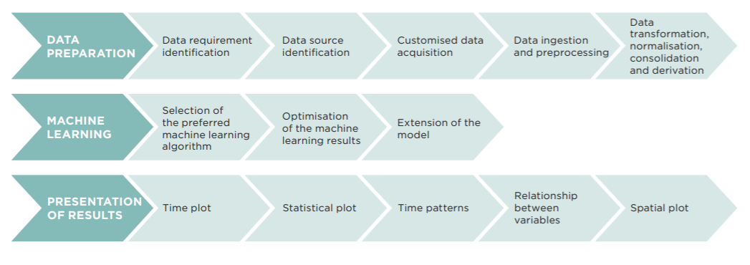
Project Requirements
Power BI
Python
R
Tableau
AWS Quick Sight
Discovery
Data Gathering
Data Pre-processing
Data Validation
Data Transformation
Data Visualization

Slide 5
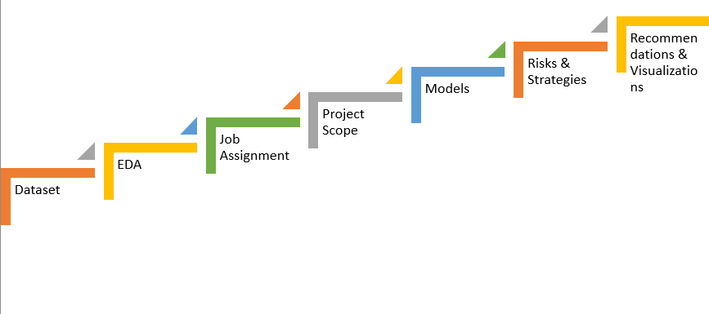
Process Roadmap

Slide 6
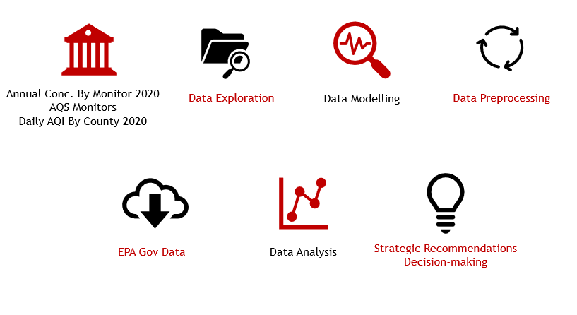

Slide 7
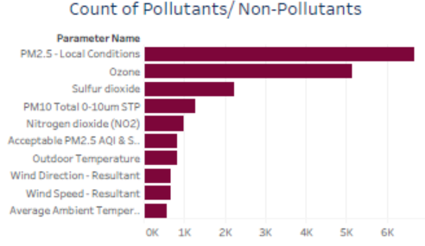
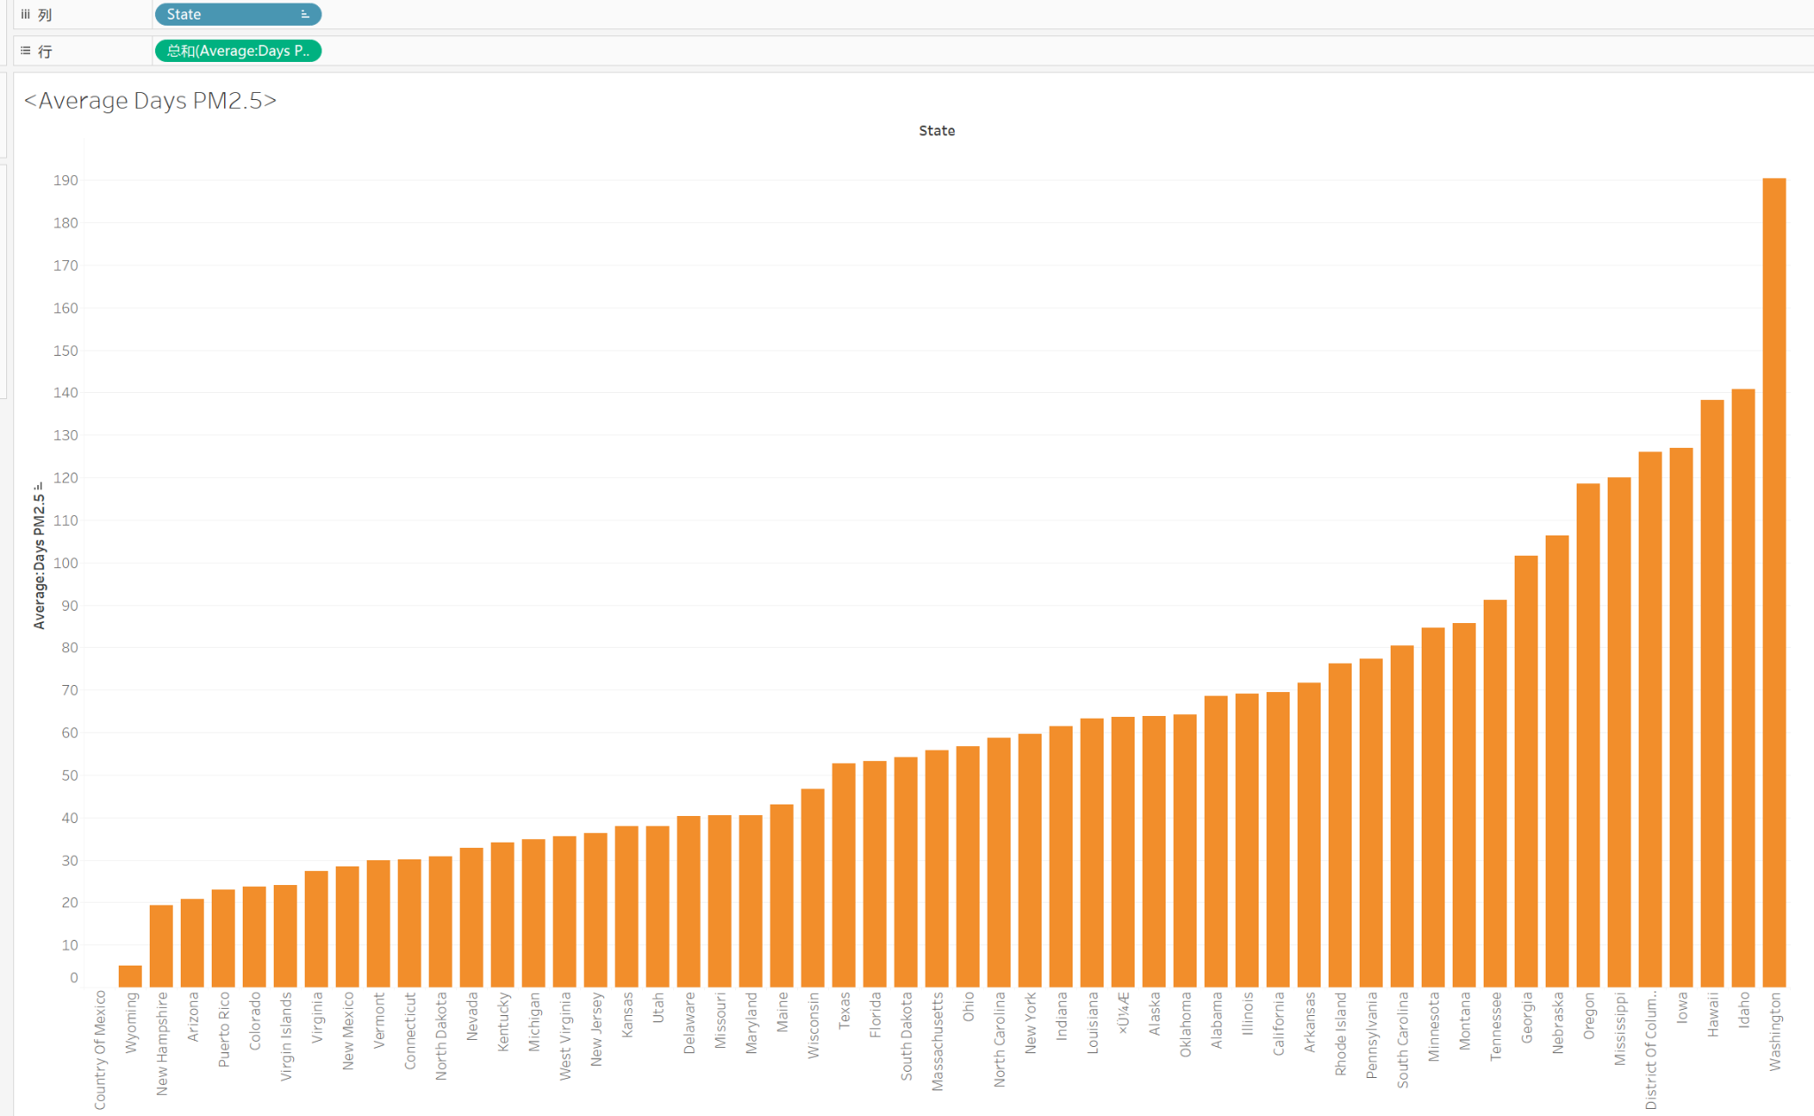
EDA

Slide 8
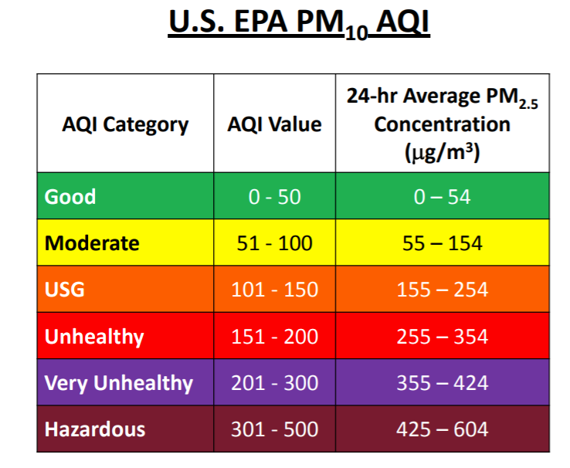
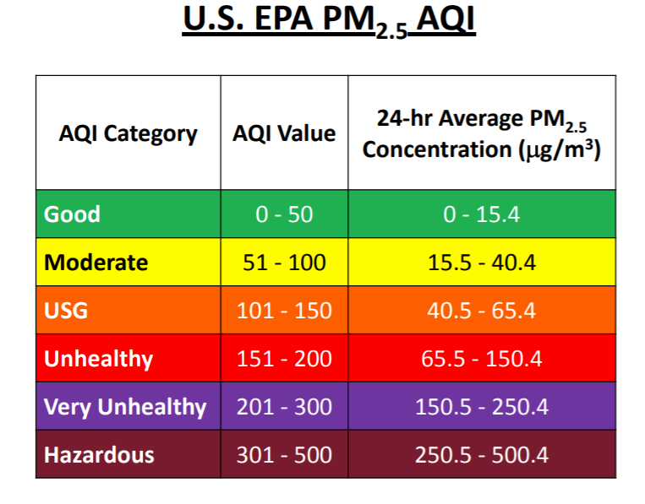
Methods to communicate the results

Slide 9
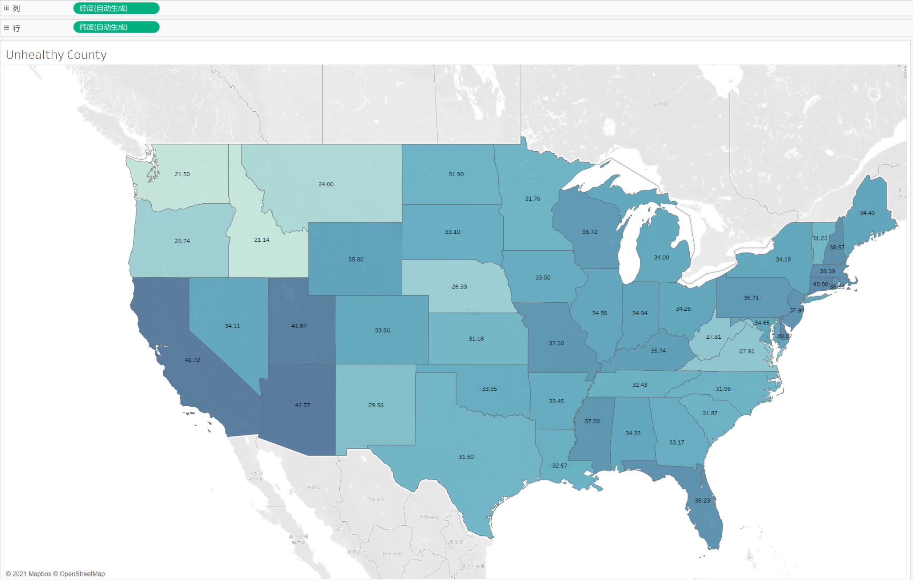
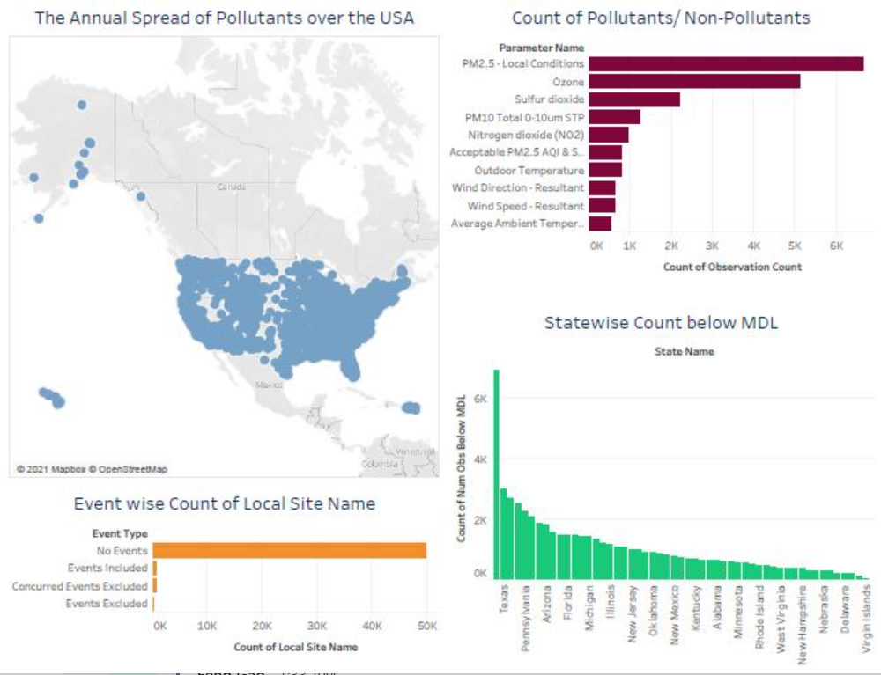
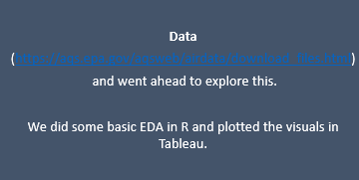
County’s Representation of Unhealthy
Notes:
We will continue to subdivide all EDA to make the analysis more accurate

Slide 10
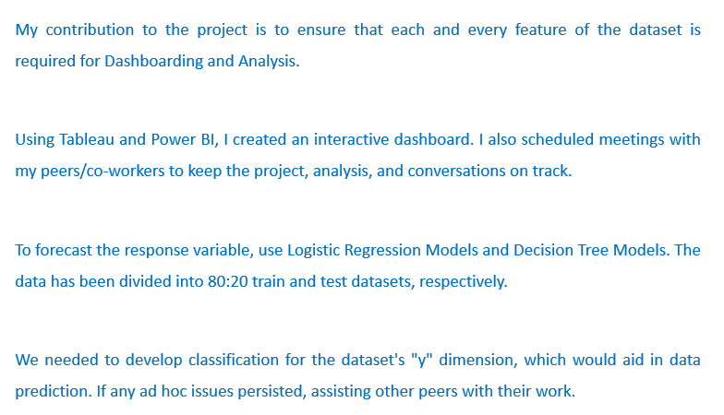
Individual Contribution
Notes:
We are planning use these 4 models and compair which one will be better

Slide 11
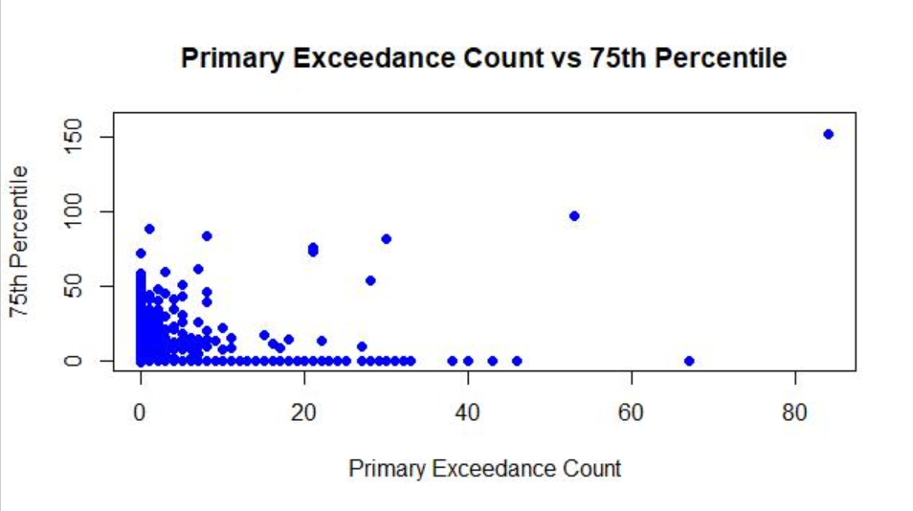
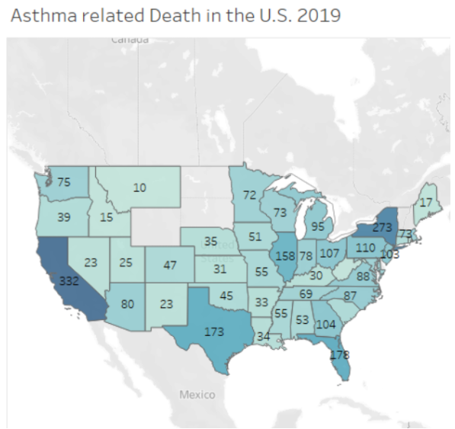
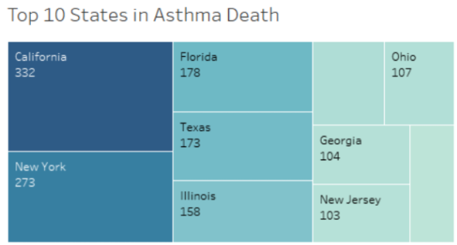
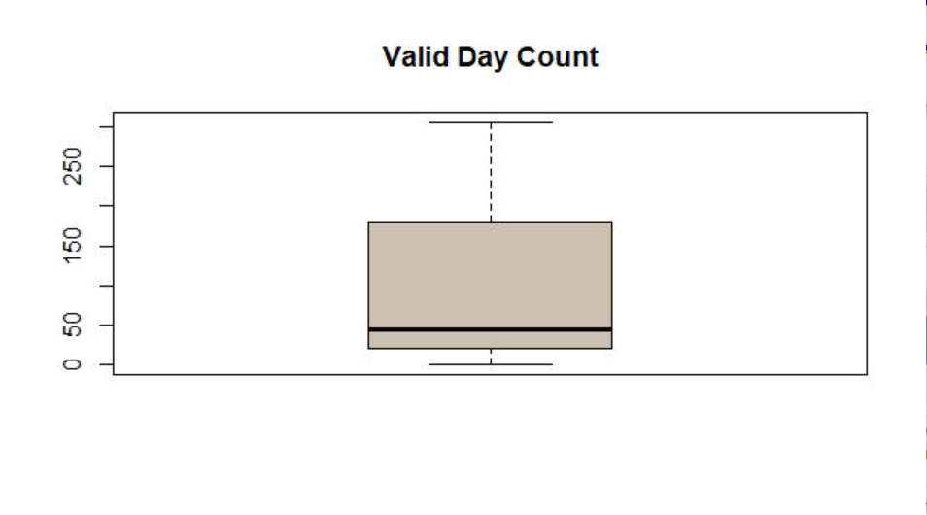
Presentation

Slide 12
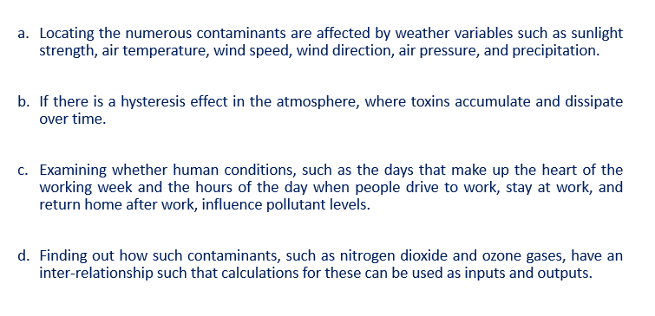
Pending Works

Slide 13
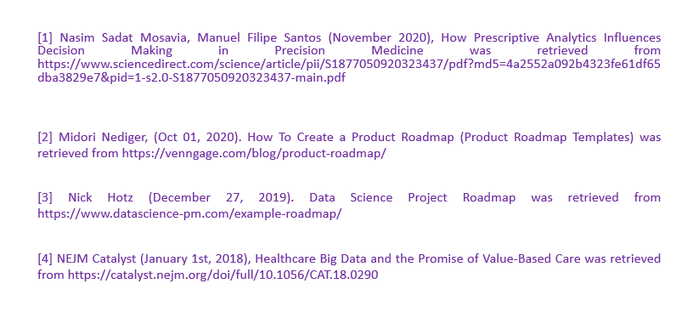
References

Slide 14
THANK YOU

